Slide 1


SWE111
Cyclometric Complexity
Instructor:
Nusrat jahan
Lecturer, SWE, DIU.

Slide 2
What is Cyclomatic Complexity?
Cyclomatic complexity is a software metric used to measure the complexity of a program. These metric, measures independent paths through program source code.
Independent path is defined as a path that has atleast one edge which has not been traversed before in any other paths.
Cyclomatic complexity can be calculated with respect to functions, modules, methods or classes within a program.

Slide 3
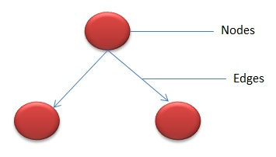
Node & Edge

Slide 4
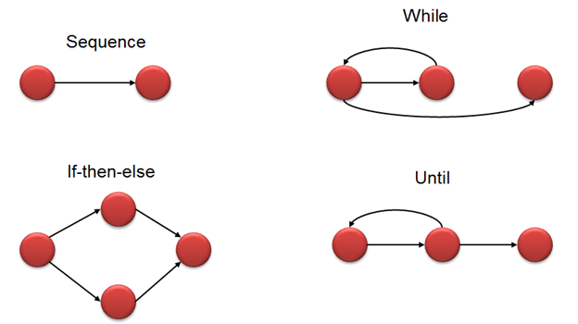
Flow graph notation for a program:

Slide 5
Cyclomatic Complexity Calculation
Cyclomatic complexity is computed in one of three ways:
The number of regions of the flow graph corresponds to the cyclomatic complexity.
V(G) = E - N + 2
Where,
E - Number of edges
N - Number of Nodes
3. V (G) = P + 1
Where
P = Number of predicate nodes (node that contains condition)

Slide 6
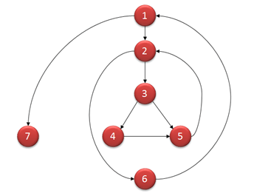

Slide 7
Computing mathematically,
V(G) = E-N+2
9 - 7 + 2 = 4
V(G) = 3 + 1 = 4 (Condition nodes are 1,2 and 3 nodes)
V(G)= Number of regions=4
Basis Set - A set of possible execution path of a program
1, 7
1, 2, 6, 1, 7
1, 2, 3, 4, 5, 2, 6, 1, 7
1, 2, 3, 5, 2, 6, 1, 7

Slide 8
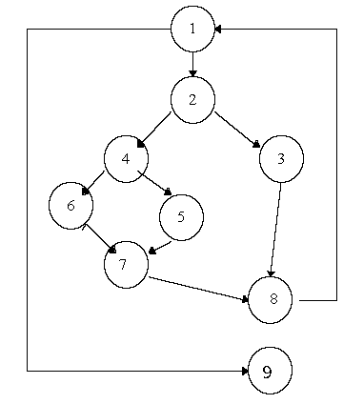
Cyclomatic Complexity

